Slide 1


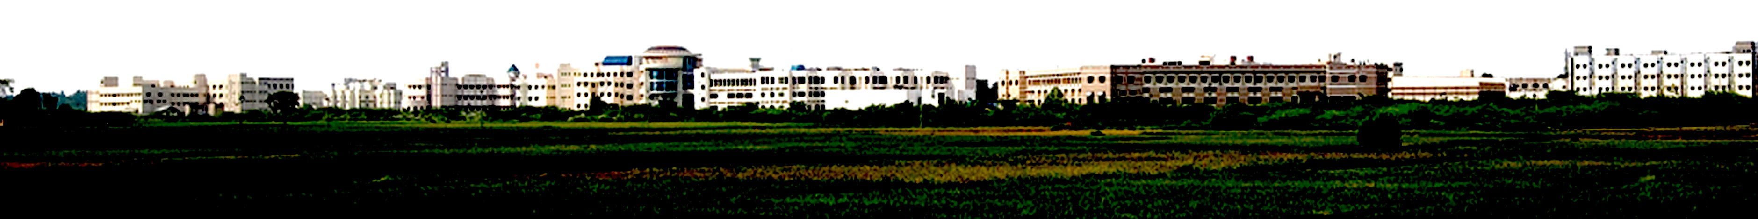
Hardware Implementation of Lossless Image Compression
Presented by
Abhishek S R
Deepan Raj K
Vidhya Vinayaga K G
Department of ECE
School of EEE
Supervised by
Dr.J Siva
School of EEE
SASTRA

Slide 2
Abstract
This project presents a hardware-based lossless image compression system designed for real-time processing. The method uses predictive coding, where each pixel is estimated from its neighboring pixels and only the prediction error is encoded. The residual errors are mapped to non-negative values and compressed using Golomb–Rice entropy coding. An escape unit is incorporated to efficiently handle large residual values that fall outside the normal coding range. The encoder is implemented in SystemVerilog HDL to enable parallel execution with low latency and high throughput while ensuring pixel-perfect reconstruction with low hardware complexity.

Slide 3

Objective and Pipeline
Objective
The objective of this project is to design a hardware-based lossless image compression encoder capable of real-time processing. The system uses MED predictive coding and Golomb–Rice entropy coding to compress prediction errors efficiently. An escape unit is integrated to handle large residual values that cannot be efficiently encoded. The performance is evaluated using compression ratio, PSNR, execution time, and hardware resource utilization.
Pipeline
The encoder follows a stream-based pipeline architecture where pixels are processed sequentially. A line buffer stores neighboring pixels required for prediction, and the MED predictor estimates the current pixel value. The residual generator computes the difference between the actual pixel and the predicted pixel.
The residual values are converted to non-negative values using a signed mapper and compressed using Golomb–Rice coding with an adaptive parameter k. The escape unit handles large residual values, while the bit packer and output writer generate the final compressed bitstream.

Slide 4
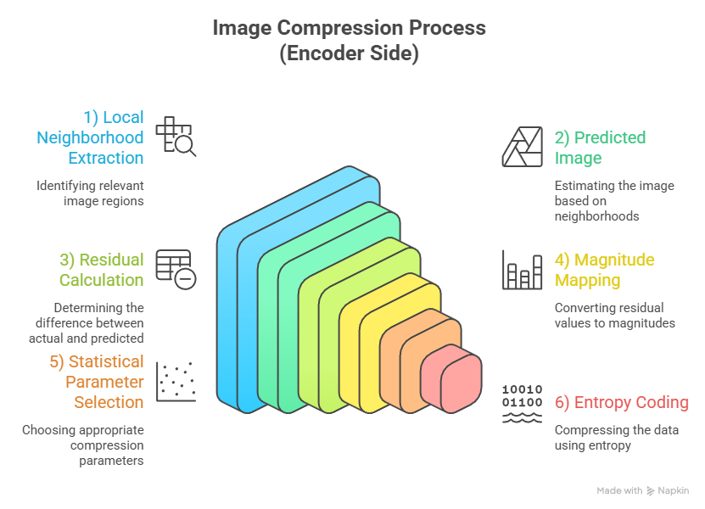
Working Process

Slide 5
Escape coding
Escape coding is used to handle residual values that cannot be efficiently represented using standard Golomb–Rice encoding. In predictive compression, most residual values are small, but occasionally large errors can occur due to sharp edges or sudden intensity changes in the image.
When such large residual values appear, encoding them with Golomb–Rice coding can produce very long unary codes. This increases the bitstream size and reduces compression efficiency.
To solve this problem, an escape unit detects these large residual values and activates escape mode. Instead of Golomb–Rice coding, the residual value is transmitted using a fixed-length representation.
This mechanism prevents inefficient encoding and ensures that all residual values can be encoded reliably while maintaining stable compression performance and simple decoding.

Slide 6
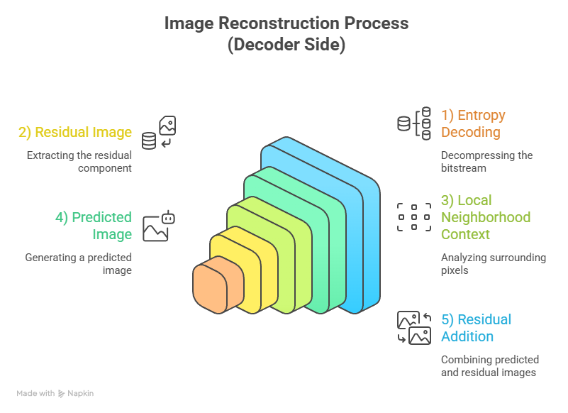

Slide 7
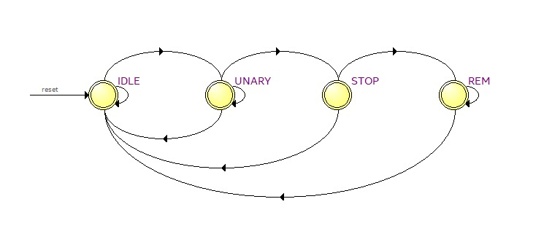
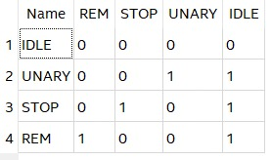
Rice Encoder FSM

Slide 8
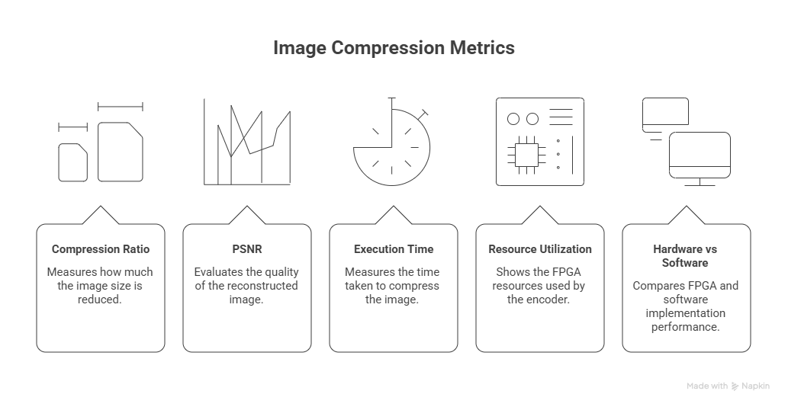
Performance Metrics

Slide 9
Obtained parameters
(For 3072 x 4080 Greyscale image)
Original file size : 1,25,33,760 bytes
Parameters Method | Compression ratio | Bits Per Pixel for compressed file | Data Retention | File size (Bytes)
BMP | 0.9999142390192 | 8.000686146691 | Lossless | 1,25,34,838
TIFF | 0.9999905057347 | 8.0000759548435 | Lossless | 1,25,33,882
PNG | 3.2160803465652 | 2.4875000428842 | Lossless | 38,97,217
HEIC (lossy) | 3.3328939558966 | 2.4003163934592 | Lossy | 37,60,624
JPG (lossy) | 8.4834831542048 | 0.9430088861595 | Lossy | 14,77,431
Proposed algorithm (.bin) | 3.9025204338251 | 2.0499572354983 | Lossless | 32,11,709

Slide 10
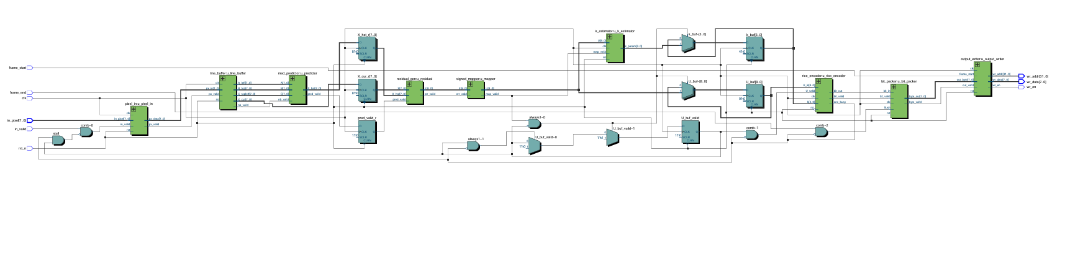
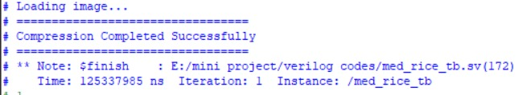
Synthesis and Testbench Results

Slide 11
Time Line
Weeks 1–2: Foundation & Modeling
Finalize algorithm details and precisely define the predictor and residual models.
Weeks 3–4: Encoder RTL Design
Develop Register-Transfer Level (RTL) architecture for the Line Buffer, Predictor, and Entropy Encoder.
Weeks 5–6: Decoder RTL & Integration
Design the decoder RTL and integrate it with the encoder module.
Weeks 7–8: Simulation & Verification
Simulation of Encoder is verified Successfully
Weeks 9–10: FPGA Implementation & Optimization
Perform FPGA synthesis, detailed timing analysis, and implement critical optimizations with GUI.
Week 11: Evaluation & Documentation
Final performance evaluation, comprehensive testing, and completion of all project documentation.

Slide 12
THANK YOU !

